Slide 1
The Voice of the Infant
Anne McFadyen Infant Mental Health Clinical Advisor, Perinatal and Early Years Mental Health, Scottish Government anne.mcfadyen@gov.scot
Parent Infant Foundation Network Day
23rd November 2023

Slide 2
Programme for Government 2019-20
“create a multi-agency model of infant mental health provision to meet the needs of families experiencing significant adversity, including infant developmental difficulties, parental substance misuse, domestic abuse and trauma”

Slide 3
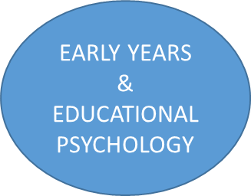
SPECIALIST INFANT MENTAL HEALTH TEAMS
THIRD SECTOR
SERVICES
MATERNITY & NEONATAL PSYCHOLOGICAL INTERVENTION TEAMS
PERINATAL
MENTAL
HEALTH
TEAMS
ADULT MENTAL HEALTH, ADDICTIONS & LEARNING DISABILITY TEAMS
CHILD & FAMILY SOCIAL WORK
UNIVERSAL
PARENTS/CARERS
ACUTE & COMMUNITY PAEDIATRICS
FAMILIES
SERVICES*
CAMHS***
NDS**
* Health visitors, Family nurses, Midwives, General Practitioners
** Neurodevelopmental Services *** Child and Adolescent Mental Health Services

Slide 4
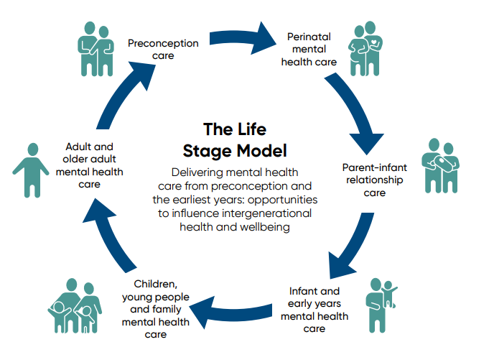
Mental Health and Wellbeing Strategy

Slide 5
What’s Important
Equality and equity
Evaluability
Coproduction
Raising awareness and tackling stigma
The infant at the centre Getting it right for every child (GIRFEC) The Promise UNCRC & infants’ rights and voice UNICEF Baby-Friendly Accreditation
Workforce training, recruitment & retention
Quality improvement approach
Recovery

Slide 7
What’s Important
Equality and equity
Evaluability
Coproduction
Raising awareness and tackling stigma
The infant at the centre Getting it right for every child (GIRFEC) The Promise UNCRC & infants’ rights and voice UNICEF Baby-Friendly Accreditation
Workforce training, recruitment & retention
Quality improvement approach
Recovery

Slide 8
Getting it right for every child (GIRFEC)

Slide 9
“Getting it right for every child (GIRFEC) underpins our approach to improving outcomes for babies, children, young people, and families.”
“The GIRFEC principles of joint working, co-operation and communication between practitioners and services…”
“GIRFEC provides Scotland with a consistent framework and shared language for promoting, supporting, and safeguarding the wellbeing of children and young people; through flexible family support where it is needed, for as long as it is needed.”
“GIRFEC is the national approach in Scotland to improving outcomes and supporting the wellbeing of children and young people by offering the right help at the right time from the right people.”
Notes:
GIRFEC
We see it mentioned across government policy and sitting at the top of micases and PQs. We’ll hear it mentioned by our stakeholders and possibly within our own communities in nurseries, health clinics and other settings.
But what is it and why is it important within and across our collective policy areas?

Slide 10
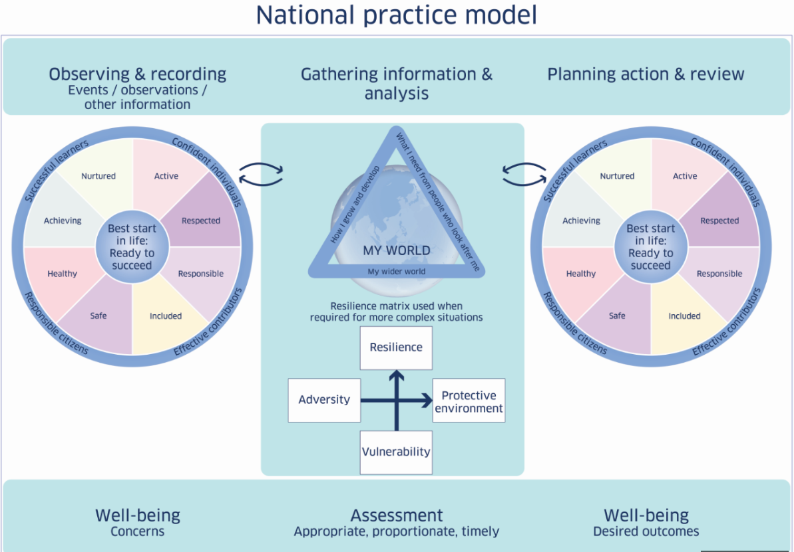
Notes:
The GIRFEC National Practice model provides a common language and approach that supports everyone working with children, young people and families; and families themselves, to think about wellbeing in the same way and tailor any help which suits the needs of individual children and young people.
Two of the key components are the ‘wellbeing indicators’ and the ‘My World triangle’ which we’ll come on to look at now…

Slide 11
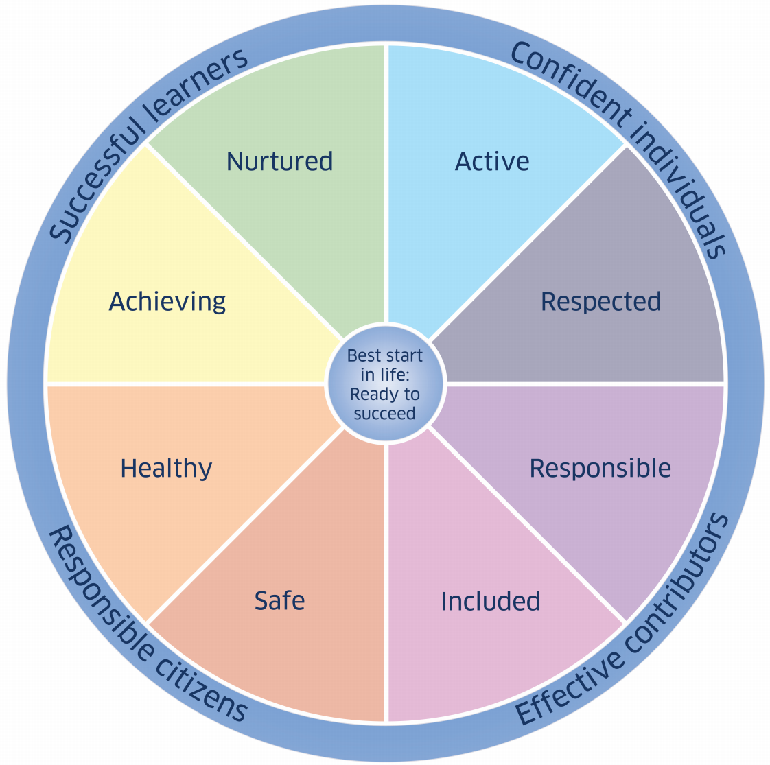
Wellbeing indicators
Safe
Healthy
Achieving
Nurtured
Active
Respected
Responsible
Included
Notes:
The GIRFEC wellbeing indicators of (…) are enshrined in legislation through the Children and Young People (Scotland) Act and practitioners in Scotland should consider, describe and discuss wellbeing holistically using these 8 terms. This common wellbeing ‘language’ in Scotland helps shape conversations with children and young people, and their families.
You will hopefully recognise how your policy area, and those of your colleagues, are reflected within the indicators, in what you are trying to achieve.
This might include through activity directly related to children and young people, or through whole-family, whole-community or whole-service policy areas which will help promote a child or young person’s wellbeing.

Slide 12
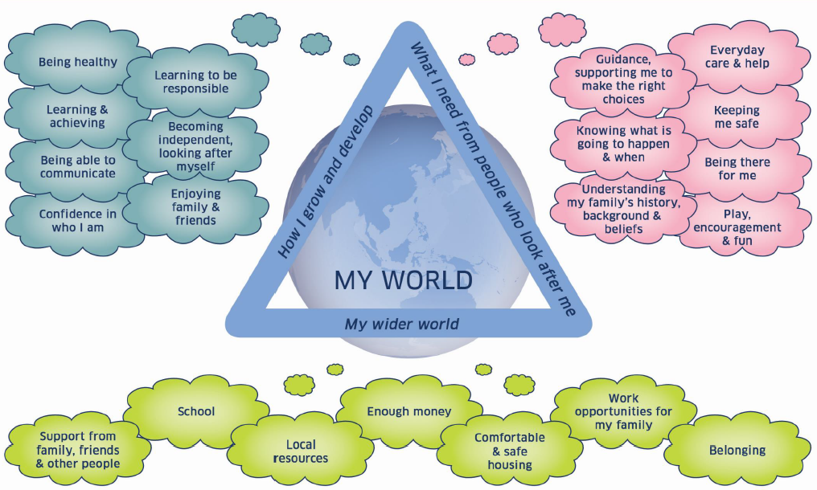
Notes:
The My World Triangle helps us think about the world around the baby, infant, child or young person (including their family, community and society), and also the strengths and pressures in that world as well as the support which might be needed.
This support could be considered through the lens of:
Individual drivers: including their early childhood (and later) development; and their personal physical and mental health
Family drivers such as: Family relations, family structure and family health, including wellbeing at the pre-birth stage
Daily environment drivers such as: Professional support available, peer relationships, and pressures and expectations
Community drivers such as: their Participation in what is around them, their social networks, access to social support; and trust and safety
And structural drivers such as: Our policy decisions in government, the wider economy and labour market, child poverty, housing, inclusion and discrimination, their physical environment

Slide 13
Vision: From before they are born, all babies and young children experience the nurturing care they need to develop to their full potential
Programme vision, aim and change theory
Aim: To reduce the proportion of children with developmental concerns at 27-30 months by a quarter by 2030 (from 18% to 13.5%)
Primary drivers:
Support caregivers’ well-being & capacity to provide nurturing care
Create a culture, environment, economy and society that enhances early child development
Integrate policies and services, ensuring they are evidence based, family centred and responsive to need

Slide 14
From before they are born, all babies and young children experience the nurturing care they need to develop to their full potential
Aim: To reduce the proportion of children with developmental concerns at 27-30 months by a quarter by 2030 (from 18% to 13.5%)
Impact areas
Create a culture, environment, economy and society that enhances early child development
Support caregivers’ well-being & capacity to provide nurturing care*
Integrate policies and services, ensuring they are evidence based, family centred and responsive to need
Nurturing care*
Care givers have the security, time and headspace to provide nurturing care in a calm environment
Care givers have the knowledge and confidence to provide nurturing care
People get trusted support at the right time, while needed, including preconception
Workforce supported to have the knowledge, confidence, resources and wellbeing to support families and caregivers to be able to provide nurturing care
Wider world
Knowledge about the importance of early child development and the impact of trauma, leads to more supportive behaviours
People live in places that are baby and family friendly, can have trusted relationships and feel part of the community
We improve on wider factors affecting early child development, including the economy, poverty, housing, air quality, nutrition, domestic violence, physical environments and racial inequalities
Integrated policies and services
Investment is optimised to reflect the evidence on primary prevention, addressing needs, inequity and enabling continuity of support
Policies and services that impact on early child development​ are integrated through a shared evidence base, common narrative and governance and communication structures
Learning system enables evidence into practice reliably and consistently, and data are shared and used to link planning, monitoring and improvement
Local partnerships can break down silos to implement evidence driven policies and apply the GIRFEC principles in ways that reflect local and community needs and lived experience
Leadership across all public sectors and services understand and champion the importance of ECD, and the need to take a whole system approach
*nutrition & health - play & stimulation - sensitive responsive caregiving - safe from harm

Slide 15
What’s Important
Equality and equity
Evaluability
Coproduction
Raising awareness and tackling stigma
The infant at the centre Getting it right for every child (GIRFEC) The Promise UNCRC & infants’ rights and voice UNICEF Baby-Friendly Accreditation
Workforce training, recruitment & retention
Quality improvement approach
Recovery

Slide 16
The five principles of The Promise Scotland
Voice Children must be listened to and meaningfully and appropriately involved in decision-making about their care, with all those involved properly listening and responding to what children want and need. There must be a compassionate, caring, decision-making culture focussed on children and those they trust.
Family Where children are safe in their families and feel loved they must stay – and families must be given support together to nurture that love and overcome the difficulties that get in the way.
Care Where living with their family is not possible, children must stay with their brothers and sisters where safe to do so and belong to a loving home, staying there for as long as needed.
People The children that Scotland cares for must be actively supported to develop relationships with people in the workforce and wider community, who in turn must be supported to listen and be compassionate in their decision-making and care.
Scaffolding Children, families and the workforce must be supported by a system that is there when it is needed. The scaffolding of help, support and accountability must be ready and responsive when it is required

Slide 17
What’s Important
Equality and equity
Evaluability
Coproduction
Raising awareness and tackling stigma
The infant at the centre Getting it right for every child (GIRFEC) The Promise UNCRC & infants’ rights and voice UNICEF Baby-Friendly Accreditation
Workforce training, recruitment & retention
Quality improvement approach
Recovery

Slide 18
Infant Rights
Babies and very young children…
have the same rights as all children and young people
face challenges which are unique to their age and stage
have agency and presence which impacts on the world and people around them, have interests & capacities that need to be nurtured
are vulnerable and are reliant on support, guidance, and at times protection in the realisation of their rights
WAIMH Position Paper on the Rights of Infants³ argues that the United Nations Convention on the Rights of the Child⁴ ‘does not sufficiently differentiate the needs of infants and toddlers from those of older children’.

Slide 19
What’s Important
Equality and equity
Evaluability
Coproduction
Raising awareness and tackling stigma
The infant at the centre Getting it right for every child (GIRFEC) The Promise UNCRC & infants’ rights and voice UNICEF Baby-Friendly Accreditation
Workforce training, recruitment & retention
Quality improvement approach
Recovery

Slide 20
Tuning into Babies’ Communications The Voice of the Infant
Infant Pledge – what babies and very young children should expect from adults
Best Practice Guidelines - how to take account of infants’ views and rights in all settings
Infant Rights Statement - clear statement on the Scottish Government’s position

Slide 22
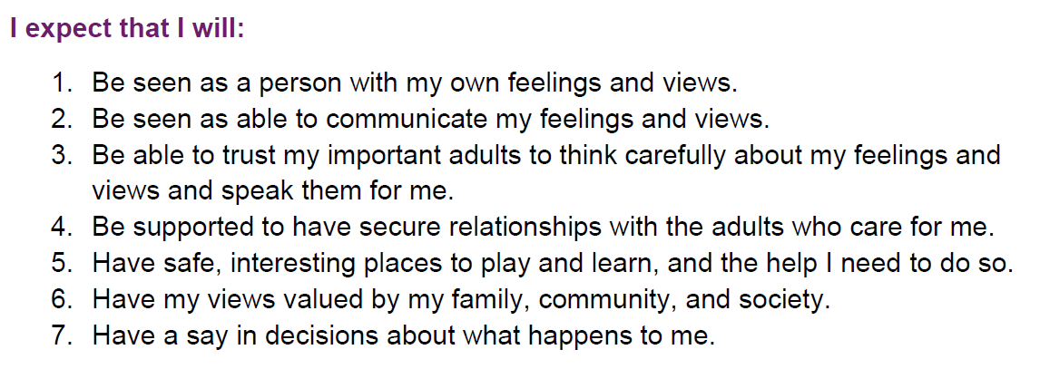

Slide 23
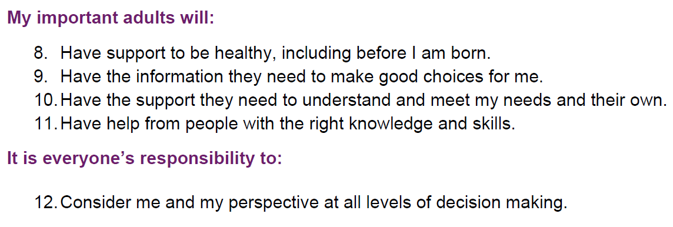

Slide 24
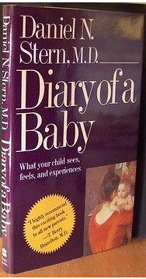

Slide 25
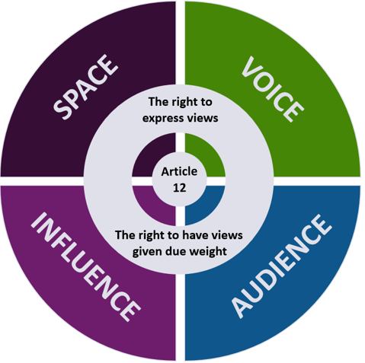
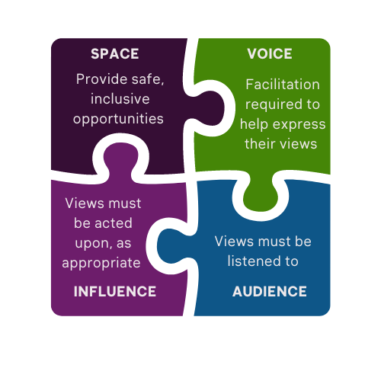
The Scottish Model of Infant Participation

Slide 26
